Slide 1


2026-2027
Kindergarten Open House
January 14th, 2026
Updated for the 2025-2026 school year

Slide 2
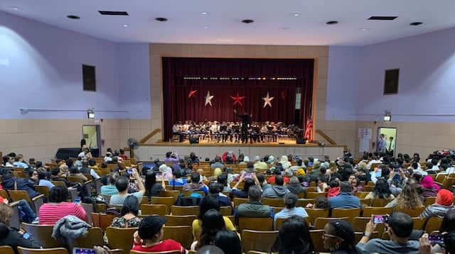
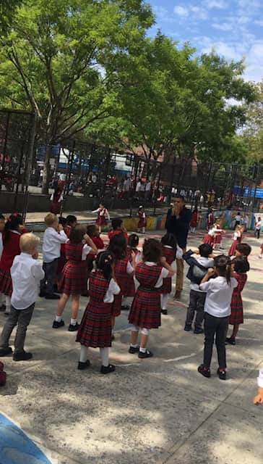

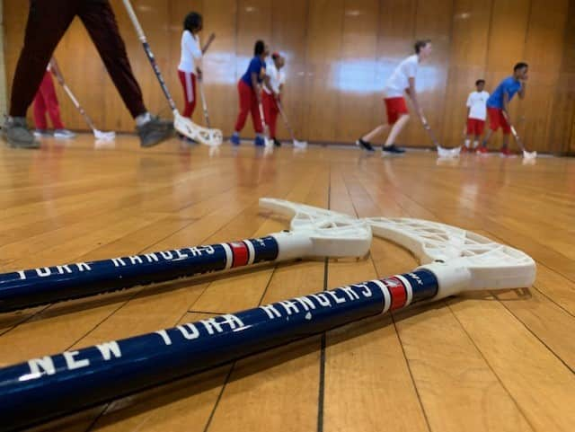
TAG is a K-8 school in NYCPS District 4 (Superintendent Dr. Dela Cruz). We are part of the Tito Puente Campus (M117) and share the building with two other schools: Esperanza Preparatory Magnet Academy (grades 6-12) and PS 138 (a District 75 school).
The schools function independently of one another, each with its own classrooms and hallways used only by its respective students and staff.
School principals coordinate lunch times, assemblies, drop-off and dismissal.

Slide 3
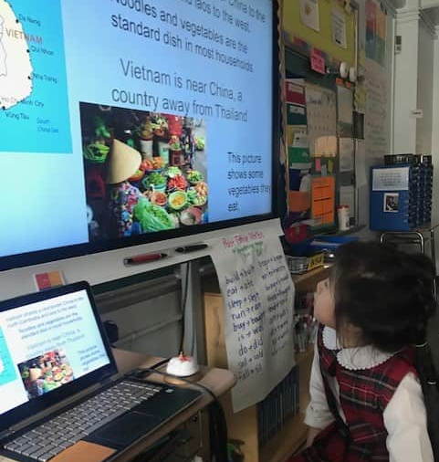
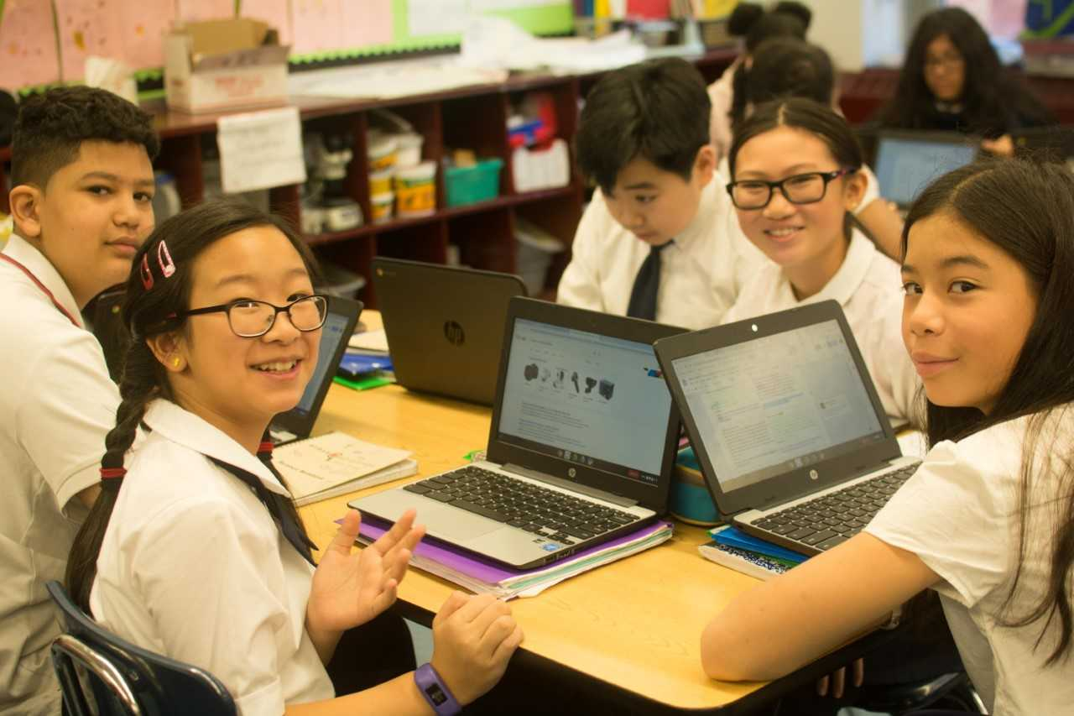
TAG incorporates best instructional practices based on research.
Differentiated instruction for all learners is an essential part
of the school culture.
The culture includes student-centered elements such as collaboration and project-based learning.

Slide 4
Eligibility Process
If you list G&T programs on your application, eligibility will be determined after you apply. Students will be considered for eligibility based on behaviors that may indicate readiness for accelerated learning.
Eligibility Process:
This varies a bit depending on where (and whether) a child currently attends pre-K.
For current pre-K students at DOE/district schools, Pre-K Centers, CBOs, or charter schools:
  Anyone who adds a G&T program to their kindergarten application will be evaluated by their current pre-K teachers.
For current pre-K students at private or parochial school programs, or for children who are not yet in school:
  Interested families apply by listing a G&T program on their kindergarten application.
  After the application closes, DOE's Division of Early Childhood Education contacts applicants to set up interviews.
  Then, interviews take place.
  Based on these interviews, early childhood education experts nominate eligible applicants for G&T admissions.

Slide 5
How Kindergarten G&T Offers Are Made
  After all applications are submitted and eligibility is determined by the Office of Enrollment, all eligible applicants are considered for offers.
  Offers are determined based on families' application choices, seat availability, and admissions priorities. All G&T programs give an admissions priority to siblings of current students
  Due to limited seats, not all eligible applicants will be made offers.
  Eligible applicants may be placed on program’s waitlists if seats are not available. Waitlists move in number order (#1, #2, #3…).
  All kindergarten applicants who apply by the deadline will receive a results letter in spring 2026. This offer may be to a Gifted and Talented program or another kindergarten program.

Slide 6
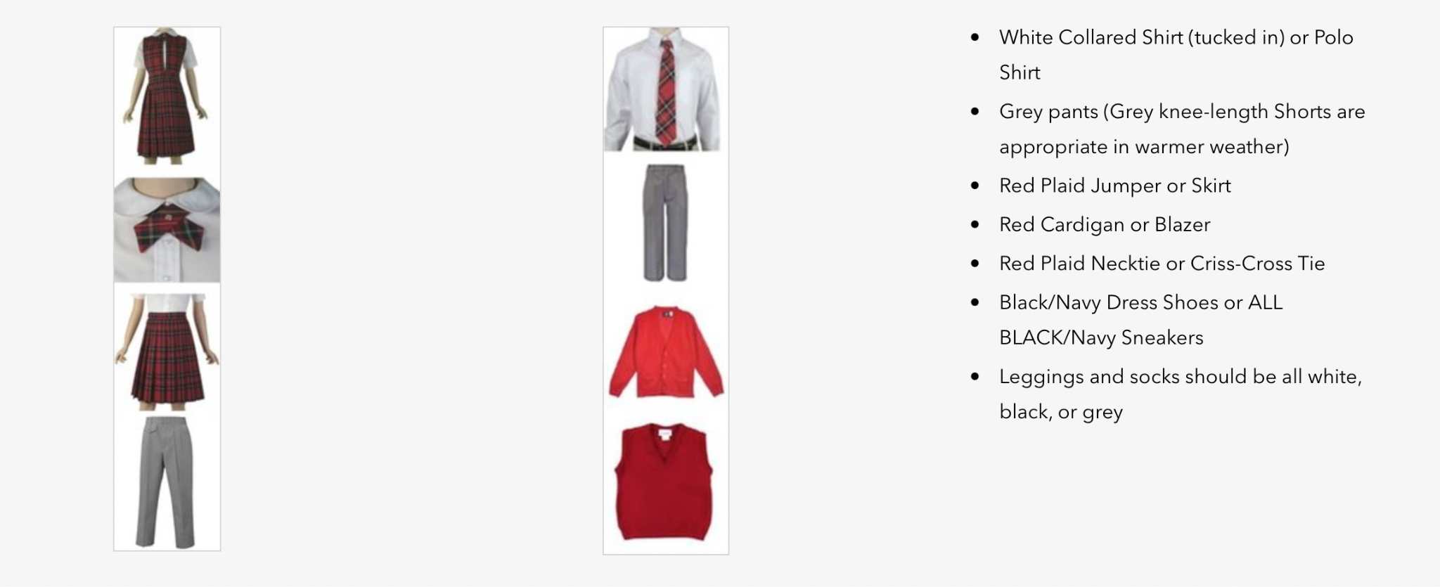
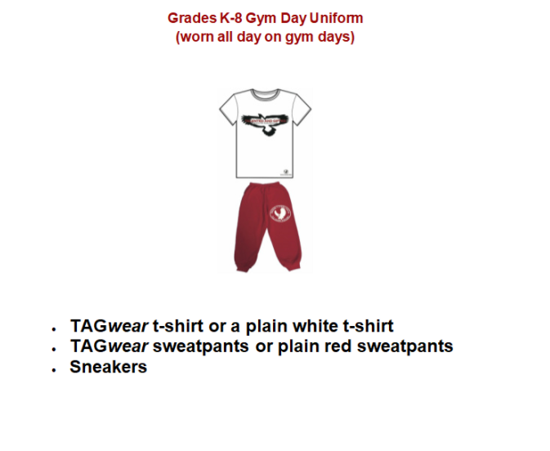
Grades K-5 Uniform

Slide 7
TAG Daily Schedule
School hours are 8:05am-2:25pm.
The school doors open at 7:35am, and free breakfast is available for all students. As elementary school students arrive, they report to the auditorium and are supervised until 8:05am.
The school day has eight periods, including lunch/recess.
1st period 8:05am-8:50am 5th period 11:14am-12:04pm(lunch/recess)*
2nd period 8:52am-9:37am 6th period 12:06 pm-12:51pm
3rd period 9:39am-10:24am 7th period 12:53pm-1:38pm
4th period 10:26am-11:11am 8th period 1:40pm-2:25pm
* Kindergarten and First Grade have recess together from 10:45 a.m.-11:11 a.m. then they go to the cafeteria to eat at 11:14 a.m.
Kindergarten and First Grade Teachers will pick the students up from the cafeteria at 11:40 a.m.
Notes:
Update to be more middle school specific

Slide 8
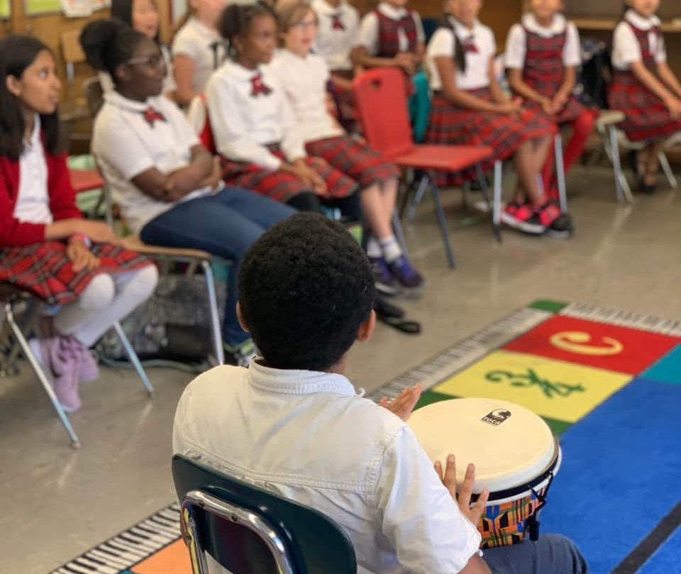

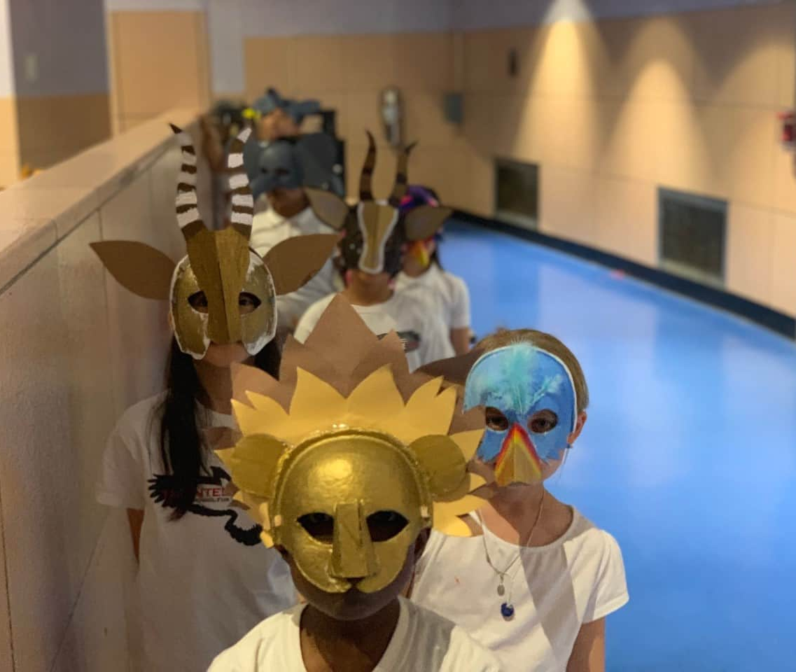
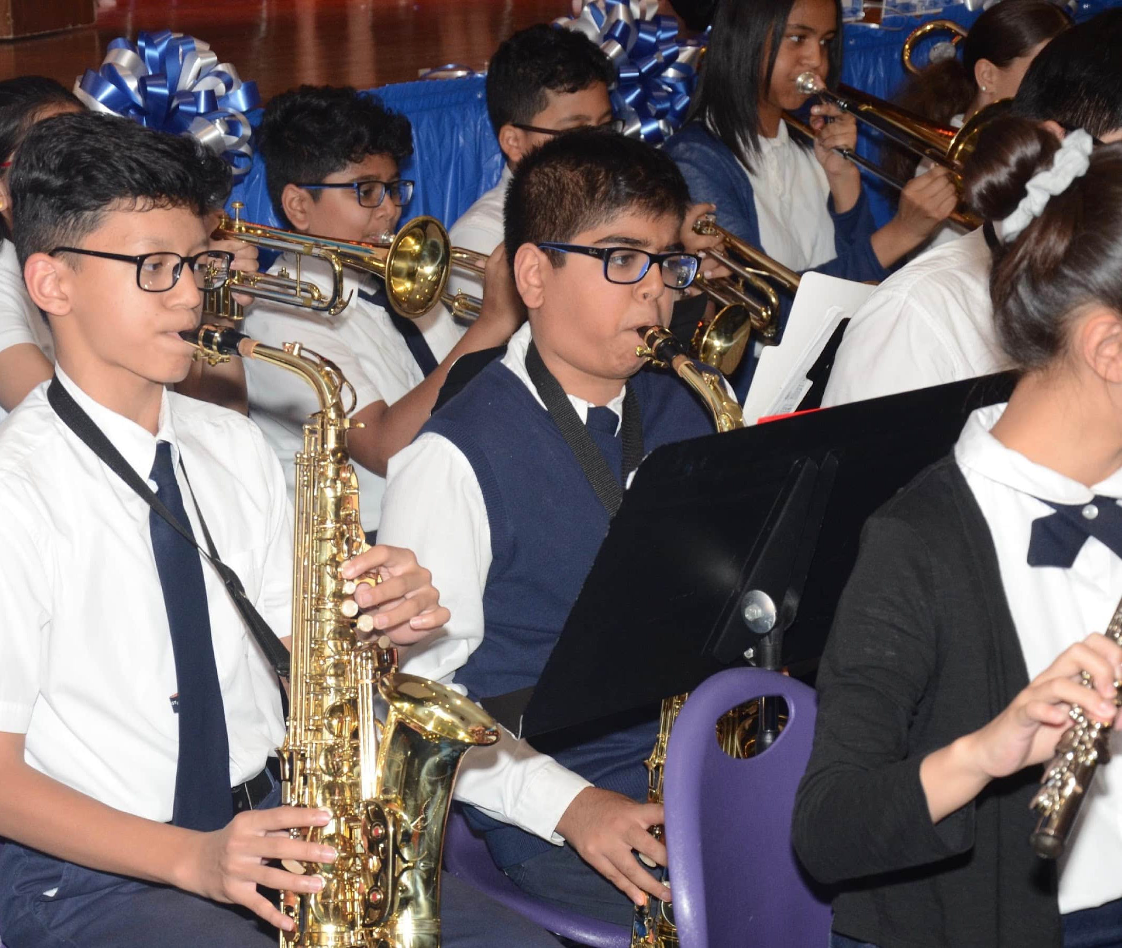
In addition to studying core subjects with teachers in their main classrooms, students attend "cluster classes" in Art, Music, Physical Education, Technology (K-5 only), Chess,(K-2, only), and Latin (1-5 only).

Slide 9
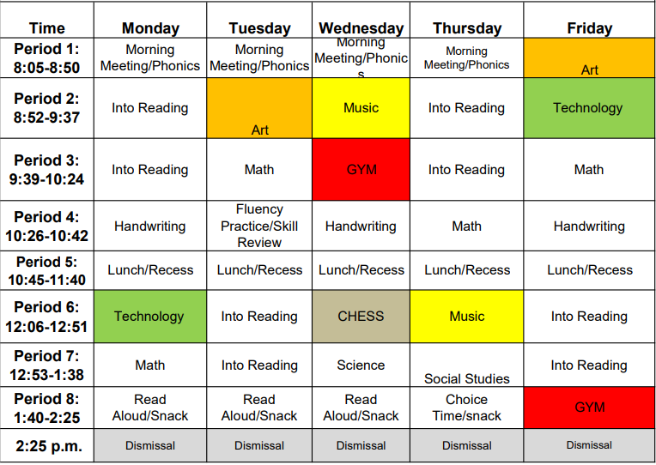
Sample Kindergarten Schedule

Slide 10

Food Services
Breakfast
Between 7:35-8:00am in cafeteria
Grab and Go breakfast after 8:00am
Lunch
11:14-11:37am: K-5
11:39-12:00pm: 6th-8th grade
  The daily offered menu options support students with allergy restrictions, vegetarian and vegan preferences, and some restricted diets.
TAG is NOT a nut-free school.
All food menus will be shared at the beginning of each month.
https://www.schools.nyc.gov/school-life/food/menus

Slide 11
School-Based Support Staff
Michelle Yrigoyen, Guidance Counselor
Emely Burgos, Guidance Counselor
Erica Arias-Vidal, Community Coordinator
Violet Trifu, Multilingual Learners (MLL) Teacher Coordinator
Katelyn Dobranski, Occupational Therapist
Monica Popa, Part-Time Physical Therapist
Ashley Bermudez, Speech Therapist
Angelica Melo-Rodriguez, School Psychologist

Slide 12
K-6th Grade Busing
DOE-provided "Yellow Bus," service available to certain Manhattan residents only
Students qualify based on Department of Pupil Transportation guidelines
Eligibility depends on the grade of the student, distance from the school, etc.
Families must request bus service at the school
Many private busing companies exist, but they will establish a route only if enough students sign up to make the run profitable.
Several TAG families have united to establish private bus routes in northwestern Manhattan, and in parts of
Queens.
https://www.schools.nyc.gov/school-life/transportation/bus-eligibility
Notes:
Make more middle school specific – only eligible for metrocards

Slide 13

School Based Health Services:
TAG benefits from an on-site health center run by Mount Sinai Medical Center.
The clinic is open on school days from 8:30am-3:00pm.
The following services are available:
Primary Care and Preventative Health Services:
Comprehensive physical examinations
Mandated school health services
Medical care and treatment for chronic illness and disease
Dispensing and prescribing of medications.
First aid care to all students registered in the building.
Emergency care to anyone in need on school premises.

Slide 14
PTA After School Enrichment Programs:
TAG PTA Inc., is a 501(c)(3) nonprofit organization designed to support and expand curricular and enrichment options for TAG students.
Previous Programs have included:
Chess (Grades K-8)
Girls Who Code (Grades 3-6)
Creative Writing (Grades 4-8)
Robotics (Grades K-5)
Debate (Grades 4-8)
Math Circles (Grades 3-8)
Mathcounts Team (Grades 6-8)
Chorus (Grades 4-6)
* The finalized list of PTA Enrichment Programs is shared each Fall
For more information about TAG's PTA, visit their website at:
TAGSCHOLARSPTA.ORG

Slide 15

YMCA After-School Program:
The school's on-site after-school program is operated by the Vanderbilt YMCA, and so long as funding is allocated, remains free of charge.
YMCA staff work in TAG classrooms, with students divided by grades, supervising homework and offering enrichment activities such as SHSAT prep, art, crafts, drama, and recreation.
Families have to apply for the program EACH YEAR
  Acceptance into the program is based on space and staff availability

Slide 16

92NY After-School Program:
92NY’s Afterschool Program provides fun and structured childcare, 1-5 days a week, for kids in grades K-5.
After School combines free play (which we call After School Clubhouse), homework help and enrichment activities that boost self-confidence and allow children to navigate group environments and build social skills. Clubhouse fee: $600.
Enrichment activities include fine arts, jewelry, ceramics, team sports, swimming, gymnastics, dance, music (including private lessons), theater and so much more! Please note that there is an additional fee associated with our enrichment activities.
  We also offer school pick-up for kids from select schools for an additional fee
    If your child is a student at TAG, transportation will be offered Mon-Thu, and will cost $350 (per day).
    If you elect for school pick-up, our staff will pick your child up at their school’s ending time and bus them to 92NY. Children must be picked up by their parent or guardian by 6 pm from 92NY.

Slide 17



If you have further questions, please contact
TAG Parent Coordinator, Ms. B at:
BBOVA@SCHOOLS.NYC.GOV
(212)860-6003

